Slide 1
Chapter 13
Six Sigma
6σ

Slide 2
What is Six Sigma?
Way of systematically improving processes by eliminating defects
The term “Six Sigma” refers to the notion that if you have six standard deviations between the mean and the nearest specification limit, practically nothing will exceed the limits.

Slide 3
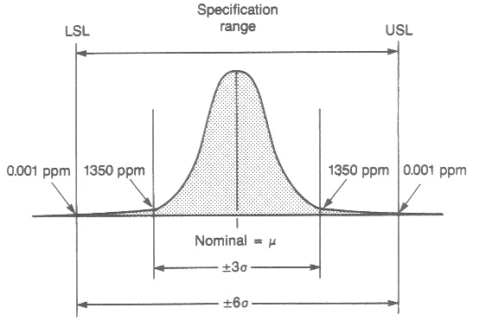
Defects and Six Sigma

Slide 4
Sigma (σ) quality levels before and after shift in the average
Sigma (σ) Levels | Defects per million opportunities (DPMO)
 | Without Shift | With Shift
1 | 317,4000 | 697,700
2 | 45,400 | 308,537
3 | 2,700 | 66,807
4 | 63 | 6210
5 | 0.57 | 233
6 | .002 | 3.4

Slide 5
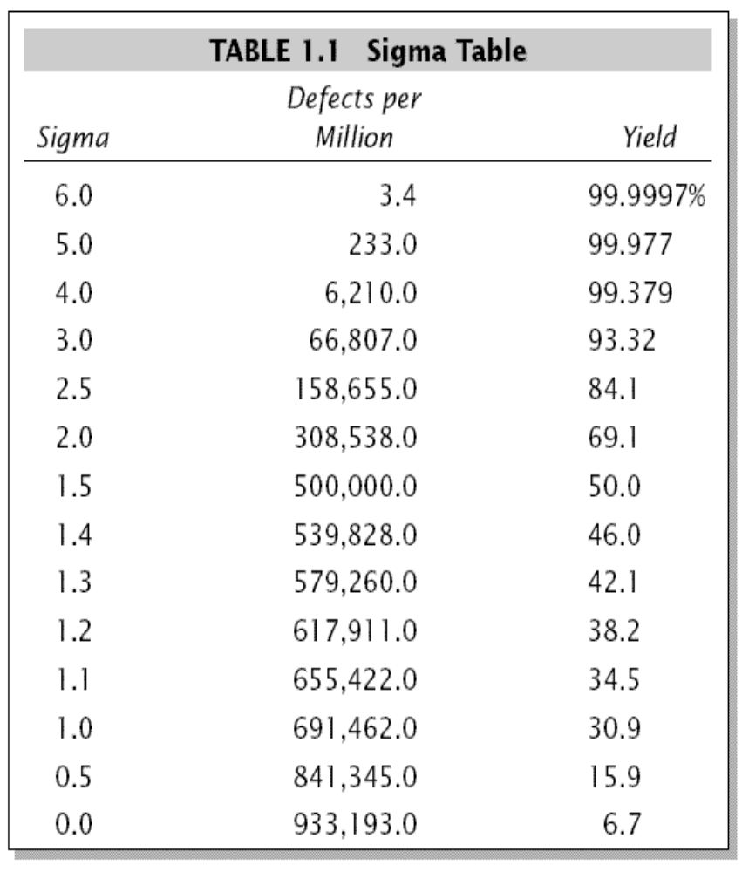
About the term 6σ

Slide 6
About the term 6σ
6σ = Near Perfection!

Slide 7
About the term 6σ
But…3.4 DPMO actually corresponds to 4.5σ
Six Sigma takes into account the “1.5σ shift”
Mikel Harry introduced the ±1.5σ shift
Example:
  Take 5 initial samples and take the mean
    Considered to be “short term”
  Take 50 samples through out the day and take the mean
    Considered to be “long term”
  Mean of initial values is different than the overall mean
Harry takes this difference to be about 1.5σ
  Overtime, mean drifts by 1.5σ
  Empirical value rather than theoretical
Many people do not agree with the concept of the 1.5σ shift

Slide 8
Definition of Six Sigma
“A business process that allows organizations to drastically improve their bottom line by designing and monitoring every day business activities in ways that minimize waste and resources while increasing customer satisfaction”.
GE defined six sigma as “a vision of quality which equates with only 3.4 defects per million opportunities for each product or service transaction and strives for perfection”.

Slide 9


History of 6σ
Initially developed at Motorola by Bill Smith in 1986
  Used old concepts and combined them
  Way of measuring defects and improving quality
  New methodology for reducing defects below 3.4 DPMO (defects per million opportunities)

Slide 10
History of 6σ
Motorola claims over $ 2.2 billion in savings that can be attributed to Six Sigma in 4 years
Many companies since Motorola have also adapted Six Sigma
  General Electric
  Bank of America
  Caterpillar
  Honeywell
  3M
  Amazon.com
  Boeing
  Whirlpool

Slide 11

Examples of 6σ
GE’s 6σ implementation
  Began in 1995 across entire organization
  Saved $320 million in first 2 years, $1 billion by 1999.
First, what it is not. It is not a secret society, a slogan or a cliché. Six Sigma is a highly disciplined process that helps us focus on developing and delivering near-perfect products and services. … Six Sigma has changed the DNA of GE
— it is now the way we work —
in everything we do and in every product we design.

Slide 12
Examples of 6σ
Geico: 97% customer satisfaction
  ~ 4σ
USPS: 95% 1st class mail delivered on time
  ~ 3σ
6σ
Can be applied to any industry, service, or
approval rating

Slide 13
6σ Key Concepts
Critical to Quality
  Attributes most important to the customer
Defect
  Failing to deliver what the customer wants
Process Capability
  What your process can deliver
Variation
  What the customer sees and feels
Stable Operations
  Ensuring consistent, predictable processes to improve what the customer sees and feels
Design for Six Sigma
  Designing to meet customer needs and process capability
Taken from http://en.wikipedia.org/wiki/Six_sigma

Slide 14
Six Sigma Methodologies
Two key methodologies
  DMAIC
    Used for improving existing processes
  DMADV
    Used for creating new product/process designs
    Used for already optimized processes (with DMAIC or another method) that still fall short of expectations

Slide 15
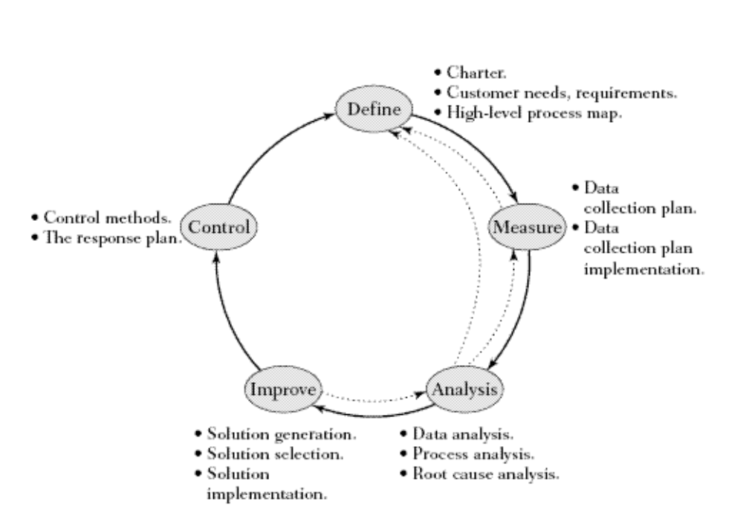

DMAIC
efine
easure
DMAIC
nalyze
mprove
ontrol

Slide 16
DMAIC: Define
Define process improvement goals
  Why the 6σ program is in place?
Define customers needs
  Need vs. requirements to fulfill need
Create high level process map

Slide 17
DMAIC: Measure
Measure current process and collect relevant data
Develop data collection plan
Collect data from many sources to determine types of defects
Compare to customer surveys
Determine shortfalls

Slide 18
DMAIC: Measure
Determine unit, defect, opportunity
  Unit = Value of process, input, or output
  Defect = Something wrong with a unit
    Too large
    Too small
    Not equal to
  Opportunity = Way to fix the defect

Slide 19
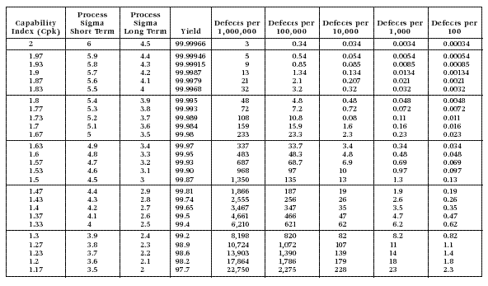
DMAIC: Measure
Find the baseline σ
Defects / Million opportunities =
Number of Defects x 1,000,000
Number of Units x Number of Opportunities

Slide 20
DMAIC: Analyze
Analyze data collected
  Identify gaps between current performance and goal performance
Determine root causes of defects
  Sources of variation
Look for opportunities for improvements
  Prioritize them

Slide 21
DMAIC: Analyze
Major factors effecting process
  Machines
  Materials
  Methods
  Mother Nature
  Measurements
  People

Slide 22
DMAIC: Analyze
Process analysis
  Subprocess Mapping
    Start with High Level Process Map from Define phase
    Reduce or eliminate inefficient steps
    Analyze map for non-value added steps
    Categorize non-value added steps
Root cause analysis
  Determine cause of defects
  Open
    Brainstorm all explanations of current sigma process
  Narrow
    Consolidate similar ideas and vote on most likely causes
  Close
    Test theories with data

Slide 23
DMAIC: Improve
Create innovative solutions to fix and prevent problems using technology and discipline
  Create a solution for each verified root cause
Select solutions
  Implement solutions either individually or in groups
  Recalculate sigma for each implementation

Slide 24
DMAIC: Control
Control improvements to keep process on new course
  Prevent reverting to “old way”
Ensure any variances are corrected before they result in defects
  Set up pilot runs
Require the development, documentation and implementation of an ongoing monitoring plan
Institutionalize the improvements through the modification of systems and structures (staffing, training, incentives, etc.)

Slide 25
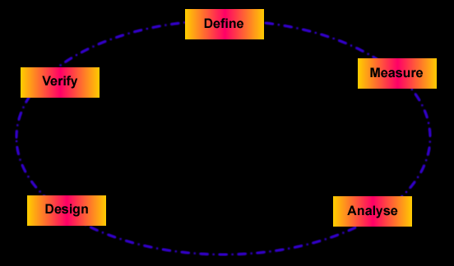
DMADV
efine
easure
DMADV
nalyze
esign
First three steps are similar to those in DMAIC
erify

Slide 26
DMADV-Design
Design details
Optimize design
Run simulations if necessary
Prepare for design verification

Slide 27
DMADV-Verify
Verify design
Set up pilot runs
Implement process
Train process owners
Hand over to process owners

Slide 28
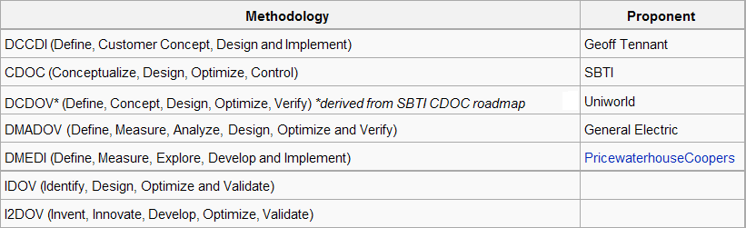
Other versions of DMADV

Slide 29
Levels of 6σ
Yellow Belt
  Trained in Six Sigma techniques as part of a corporate-wide initiative
  Have not completed a Six Sigma project
  Not expected to use Six Sigma actively for quality improvement projects.

Slide 30
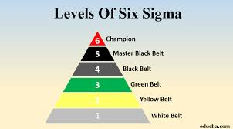

Slide 31

Levels of 6σ
Green Belt
  Focuses on 1-2 projects, part time
    Have other job responsibilities
  Direction comes from Black Belt
  Skilled at project management
  Responsible for project progress
  Lead planning teams

Slide 32

Levels of 6σ
Black Belt
  Focuses on 1-3 projects
  Full time
  Has specific projects
  Focus on project execution
  Direction comes from Master Black Belt

Slide 33
Levels of 6σ
Expert
  Used primarily in Aerospace and Defense Business Sectors
  Work across company boundaries
    Work at many different sites
    Improve services, processes, and products
  Not all companies have this level

Slide 34

Levels of 6σ
Master Black Belt
  Identified by Champions
  Act as an in-house expert coach for Six Sigma
  Supports many improvement teams, not limited to a certain number of projects
  Recruits and trains other Black Belts and Green Belts
  Deploy Six Sigma across various functions and departments

Slide 35
Levels of 6σ
Champion
  Usually senior manager
  Driving force behind organization’s 6σ implementation
  Mentor to other Black Belts
  At some companies, may be known as “Quality Leader”

Slide 36
Levels of 6σ
Executive Leadership
  CEO and other top management
  Set up vision for Six Sigma
  Choose Champions

Slide 37
Other Similar Tools
Lean manufacturing
  Developed from the Toyota Production System
    Toyota’s steady growth has led to interest in Lean manufacturing.
    Lean identifies “wastes” and eliminates them.
    Three types of waste: non-value added work, overburden, unevenness
    Seven deadly wastes: overproduction, transportation, waiting, inventory, motion, over processing, defects

Slide 38
Other Similar Tools
Lean Six Sigma
  Six Sigma with added speed focus
    Six Sigma focuses on quality
    Used by many companies, including Honeywell, GE, and Lockheed Martin

Slide 39
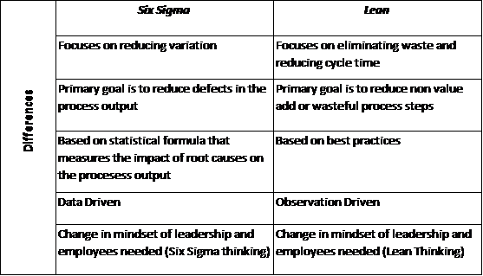
Six Sigma Vs Lean

Slide 40
TQM Versus Six Sigma
TQM | Six Sigma
A management philosophy of quality improvement | A philosophy that focuses on defect reduction and cost reduction
Encourages involvement of all employees | Relies on a selected group of highly-trained employees
Senior management provides direct support | Senior management is held accountable for results

